Slide 1
Gwisani Mavuma(Mav)
Background Information

Slide 2
Introduction
I'm Gwisani, though most know me as Mav – a shorter version of Mavuma. My journey began with a 2012 Industrial Engineering degree from Dalhousie. Swiftly after graduating, I joined Sobeys as an application developer, honing my skills in ABAP programming, .Net, Java, and JavaScript.
Later, I transitioned to Citco, an investment firm, specializing in .Net, JS, HTML, and bespoke software solutions. And now, I'm at Fix.com, where my expertise revolves around .NET, HTML, CSS, jQuery, and a spectrum of other languages. I manage five online retail store websites to ensure that customers have a seamless customer experience.

Slide 3
Introduction CONT’D.
I bring 10 years of accomplished experience as an Application Developer, along with 3 years as a results-driven .NET developer. My expertise lies in object-oriented design, spanning the entire software lifecycle from requirements to implementation, testing, and maintenance. I've successfully led the creation and management of 10+ projects and 5 websites, excelling in .NET Framework, C#, SQL Server, and web development using ASP.NET MVC and webforms.

Slide 4
PRIMARY GOAL
Why I am interested in this position?
This position resonates with my skills and career trajectory, offering a perfect fit for my diverse programming and software development experience.
The challenges presented by this role align with my innate drive for tackling complex problems and finding innovative solutions, keeping me motivated and engaged.
The Senior Full Stack Developer role holds a special appeal for me due to its commitment to continuous learning and growth. This commitment offers the chance to remain at the cutting edge of technological progress and enhance my skills even more.
The NS Government's renowned commitment to nurturing a collaborative and supportive workplace culture deeply aligns with my conviction in the potency of teamwork to attain extraordinary outcomes.
Driven by a strong desire to leverage my skills, I am enthusiastic about the opportunity to create a significant influence within the team, catalyzing positive outcomes and advancing the NS Government's mission.

Slide 5


Technical experience
Software Delivery Practices
Programming languages & technology stacks
During my tenure at Citco, I successfully employed an agile methodology to achieve regular software deliveries. This involved close collaboration among QA, operations, and development teams to ensure seamless releases with minimal bugs.
At Citco, we leveraged Docker to package and distribute software to various partners, streamlining the deployment process.
In my current role at Fix, we emphasize continuous integration by consistently incorporating changes into a shared repository. Subsequently, the QA team conducts thorough testing prior to releasing updates into production. Our standard delivery cycle occurs every three weeks, with the flexibility to address ad hoc issues affecting production promptly.
In both organizations, we placed a strong emphasis on comprehensive documentation, whether it was external documents or integrated within the codebase. This approach ensured that essential information about our projects was well-documented and easily accessible to all team members.
During my tenure at this organizations I was worked with so many languages. Below are few
C#, NET Core/.NET 5+ (cross-platform development), ASP.NET Web API (for building RESTful APIs), LINQ (Language Integrated Query), ASP.NET (for web applications) ASP.NET Web Forms, ASP.NET MVC (Model-View-Controller), ASP.NET Core (cross-platform framework)
HTML, JavaScript Libraries(Jquery), css framework(bootstrap) and many more

Slide 6
Technical experience cont’d
DB, ORM, Bindings
Design and integration Patterns
I possess significant expertise in relational databases such as MySQL, PostgreSQL, and IBM DB2. In my present role, I am actively engaged with MySQL as the primary database solution at my company.
In my present role, the website doesn't establish direct communication with the database. Instead, we configure the database through the provided Entity Framework. We furnish an encrypted connection string, which the API decrypts and uses to invoke the stored procedure created on the database.
Visual studio provides different binding methods of which we all use for example we use dependency injection, configuration files, Model-View-Control(MVC) and Ajax calls to mention the few.
We have created a common design patterns that is reference by all project we create, this is to ensure that we don’t solve the same problem many times, plus it ensures that the code is easy to read and maintain
Integration patterns – This I have never been introduce the patterns because we didn’t have high volume communication to customers/clients, but I am eager to learn

Slide 7
Technical experience cont’d
Cloud computing and Virtualization and containerization
Structured vs Unstructured Data
In my present role, I am directly engaged with both structured and unstructured data. Regarding structured data, our focus revolves around managing a customer database encompassing fields such as names, addresses, phone numbers, and purchase histories. On the other hand, when it comes to unstructured data, customers interact with our platform by posing questions via the website, submitting reviews, sharing images, and providing ratings. It falls to us to handle these diverse forms of unstructured data effectively.
I possess a functional understanding of utilizing Docker to encapsulate my applications, enabling them to be executed on various platforms.
In my present role, I've successfully connected our project with both Azure and AWS platforms. Regarding Azure, I facilitated customers in directly uploading images into our systems, which were subsequently stored within the Azure environment. On the AWS side, our partner supplied data through AWS, and I took charge of configuring AWS settings and developing a program that seamlessly retrieved the data using the AWS library.

Slide 8
Technical Walk Through
I've employed Visual Studio 2022 since it's the SDK I'm highly acquainted with and use regularly.
When it came to developing the app, I had the choice between web forms and Razor. I decided on Razor due to its status as the latest version and the gradual phasing out of web forms. Similarly, for crafting the API, I chose Swagger API for the same reasons as mentioned earlier. Additionally, it boasts comprehensive online documentation and offers a user-friendly experience.
Deployed the API to docker as requested, the web application can also be deployed to docker is need be. The reason for deploying only the api was that in order for the site to work the API have to be running on the background.

Slide 9
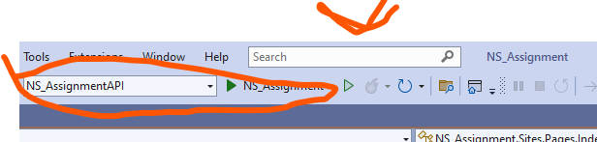
NSAssigmentapi
I chose the Swagger API. This API stores data in an in-memory database for later retrieval, capturing information such as the status of a fan when it was turned off or the state of a code pull. The API is deployable on both IIS and Docker, though I will provide detailed instructions specifically for Docker deployment.
Deploy instruction Port 8080(Change this port if not available) URL: http://localhost:8080/swagger/index.html
Open visual studio, search for terminal at the search bar, ensure NS_AssigmentAPI is selected

Slide 10
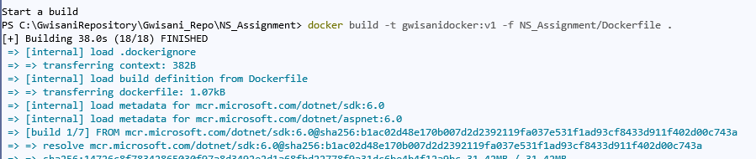
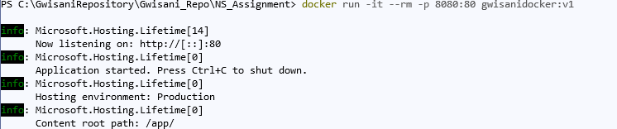
NSAssigmentapi cont’d
2. Run the docker cmd line below to deploy the API docker build -t gwisanidocker:v1 -f NS_Assignment/Dockerfile .
3. After this is done building, run the command below to start the api, and ensure the url is running before running the site.
docker run -it --rm -p 8080:80 gwisanidocker:v1

Slide 11
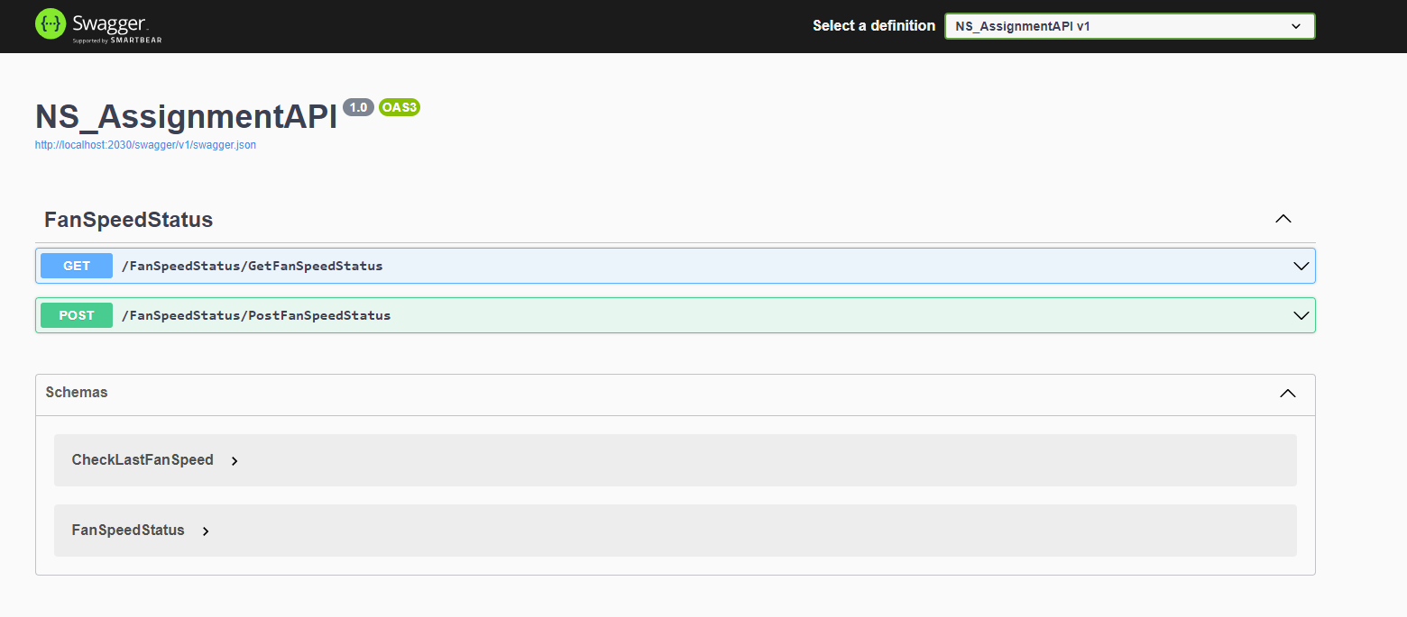
NSAssigmentapi cont’d
This is how the api should look like when running through swagger

Slide 12
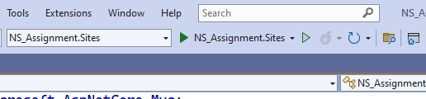
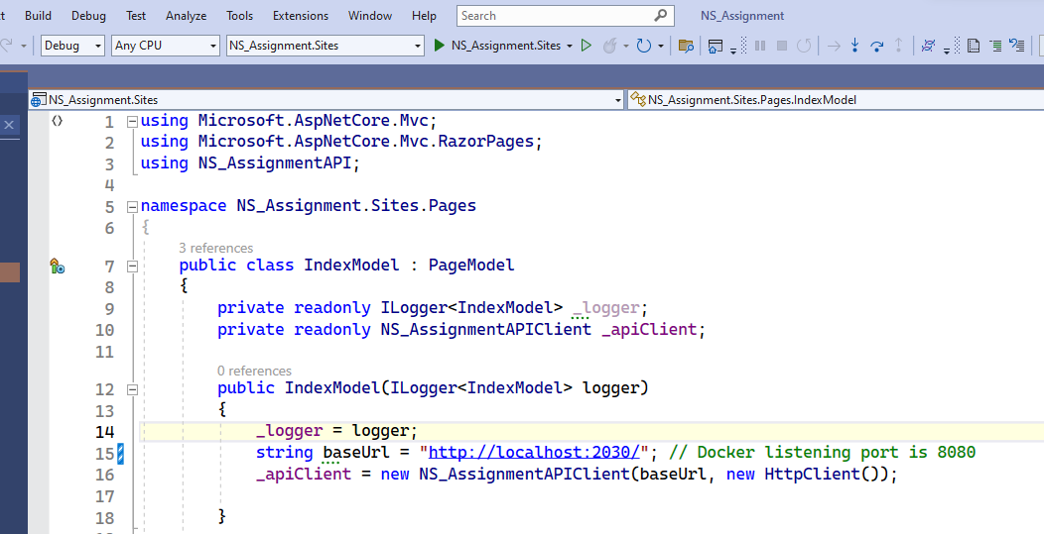
NSAssigmentapi.SITES
For sites I opted not to deploy it to docker because it can be run from visual studio in either debug mode or start without debugging, ensure that NS_Assigment.Sites is selected.
If you are using a different docker listening port change the baseurl port

Slide 13
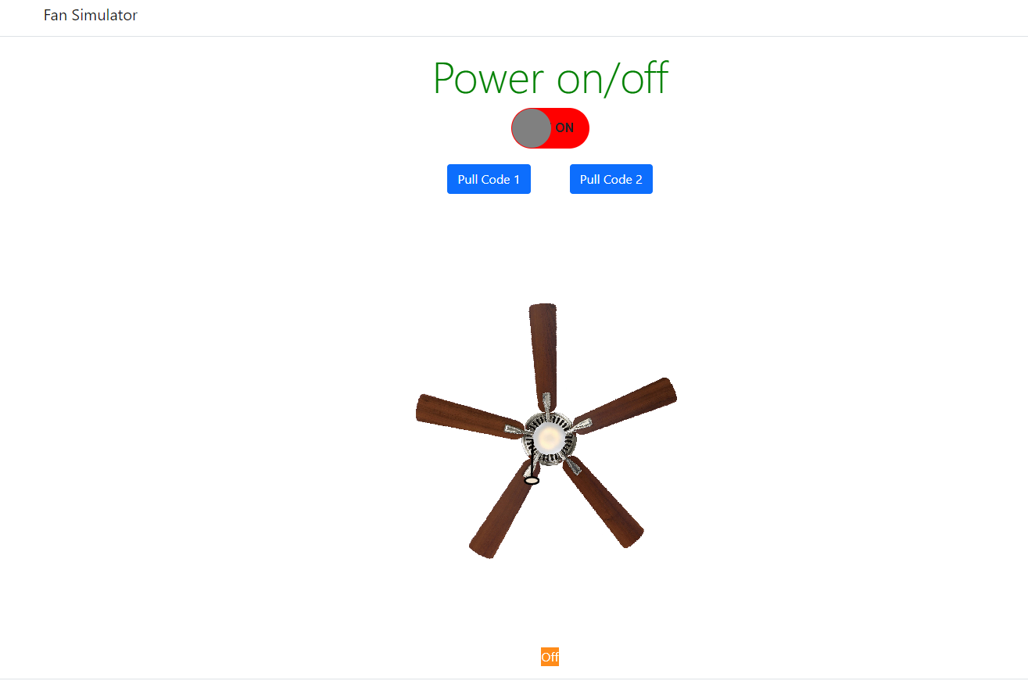
NSAssigmentapi.SITES cont’d
After running on either mode, the url below will open on index page
url: https://localhost:7190/

Slide 14
NSAssigmentapi.SITES cont’d
To test, turn on the the power and toggle between pull code 1 and 2, each action communicate directly with the inmemory database. The task fulfil all the requirements on the assignment pdf
I used the inmemory database because I wanted a place to store the settings

Slide 15
THANK YOU
Gwisani Mavuma
gmavuma1@gmail.com

